Slide 1


Predicting Customer Churn in Telecom Industry using Power BI and SQL
DATA VISUALIZATION WITH POWER BI
K.Prassana | Batch Code: MBE12 | Batch Name: BADM –WD–E–B1

Slide 2

Introduction:
Customer Churn Challenge: Customer churn, where customers discontinue a service, is a significant challenge in the telecom industry.
Importance of Reducing Churn: High competition and evolving customer demands make reducing churn essential for revenue maintenance and business growth.
Cost-Effectiveness of Retention: Retaining existing customers is more cost-effective than acquiring new ones, highlighting the importance of churn prediction.
Churn Prediction: Churn prediction is critical for proactive customer management to minimize losses.
MySQL and Power BI for Analysis: The report uses MySQL and Power BI to predict and analyze churn patterns in the telecom sector.
Identify At-Risk Customers: By analyzing churn data, telecom providers can identify at-risk customers and take corrective actions.
Data-Driven Insights: Utilizing data-driven insights helps companies improve retention, optimize marketing efforts, and enhance service quality.
Long-Term Revenue Stability: These actions contribute to long-term revenue stability and business growth.

Slide 3

Objective, Scope AND SIGNIFICANTS :
The objective is to analyze customer behavior and identify churn drivers to:
1. Detect high-risk customers and design targeted retention strategies.
2. Optimize marketing campaigns for at-risk customers.
3. Improve service offerings based on churn trends.
4. Enhance revenue by minimizing churn rates.
Using MySQL for data processing and Power BI for visualizations, this project examines demographic profiles, service usage, contract types, and financial contributions to deliver actionable insights and interactive dashboards.
Significance for the Telecom Industry:
Churn prediction helps telecom companies stay competitive by transitioning from reactive to proactive customer management. This report highlights key churn drivers and provides a roadmap for customer retention strategies, helping companies reduce churn, improve customer satisfaction, and secure their market position.

Slide 4
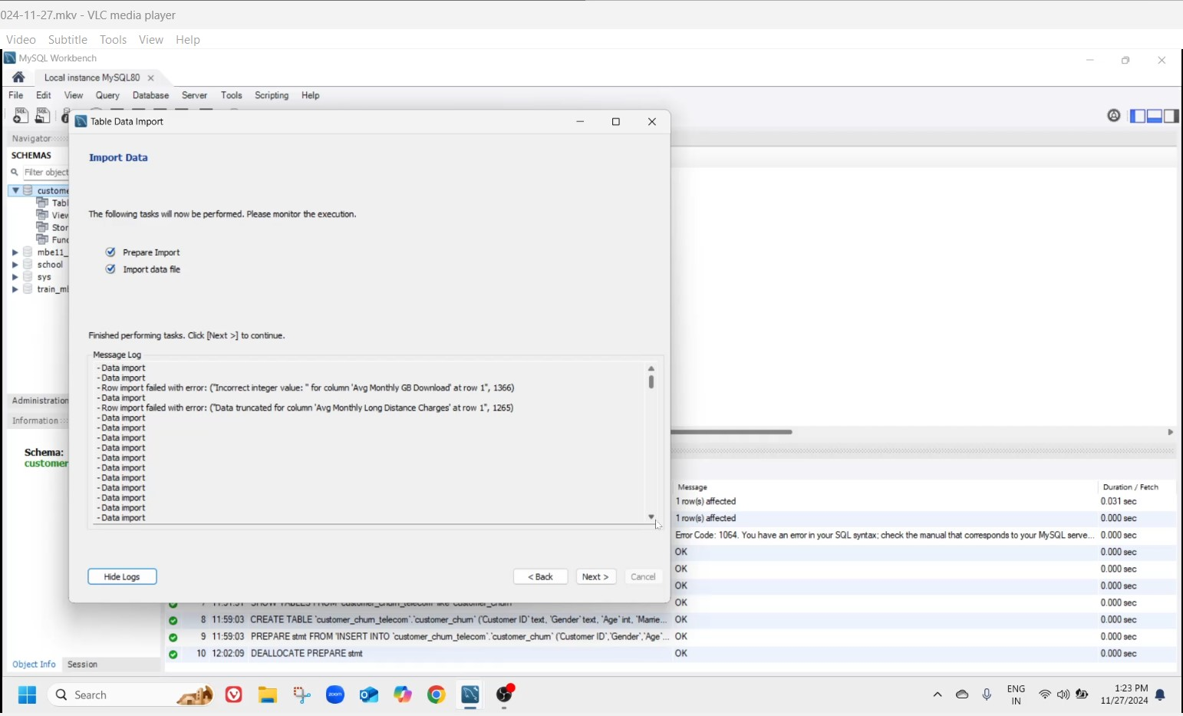
Data Cleaning in excel:
Initially, importing the Customer_churn dataset failed for 1366 rows due to 'incorrect integer value' in the column AVG_Monthly_GB_Download and 1265 rows due to 'data truncated for column' in AVG_Monthly_Long_Distance_Charges, resulting in only 4835 rows being imported.
On review, AVG_Monthly_GB_Download had 1366 empty rows, and AVG_Monthly_Long_Distance_Charges had 1265 empty rows, which were replaced with 0 as these fields are integer types. The dataset was saved as Customer_churn_edited.
Re-importing Customer_churn_edited successfully imported all 7043 rows, and this dataset was used for further processing.

Slide 5
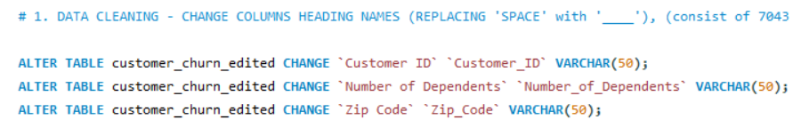
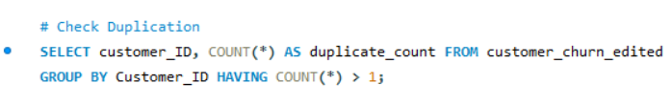
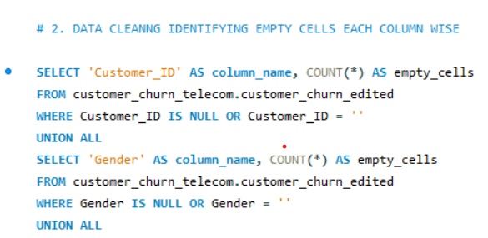
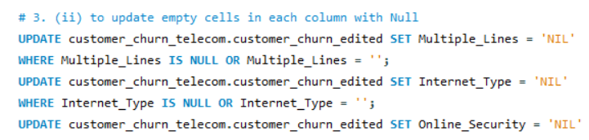
Data Cleaning in MYsql:
1. Column Name Alteration:
Replaced spaces in all 38 column headings with underscores using ALTER TABLE and CHANGE queries.
2. Identifying Duplicates:
Checked for duplicates in the Customer_ID column, as it is crucial for identifying unique customers.
Result: No duplicates were found in the dataset.
3. Identifying Empty Cells:
Used FROM and WHERE clauses with NULL condition, along with the UNION ALL operator, to check empty cells across all 38 columns.
Result: 12 columns had empty cells, all of which were of VARCHAR type.
4. Replacing Empty Cells:
Replaced empty cells in 12 columns with the value 'NIL' using the WHERE clause and OR operator.
Outcome:
The dataset is now cleaned and ready for further analysis to identify customer churn in the telecom industry.

Slide 6

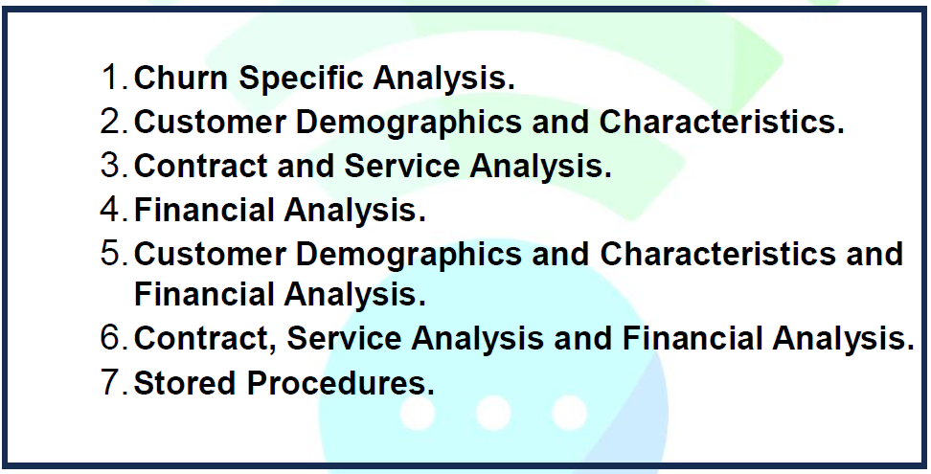
Tasks using mysql to identify the churn Rate:
The identification of Churn customers in telecom is done by classifying the28 given tasks into 7 categories:
To view the link for the detailed report containing 28 tasks
click on - > Churn Report (check form page 7 from report)

Slide 7

Procedure to Import MySQL Data into Power BI:
Open Power BI Desktop: Launch Power BI and click Get Data.
Connect to MySQL: Select MySQL Database as the data source.Enter Server Name (e.g., localhost) and Database Name (customer_churn_telecom). Provide your MySQL username and password, then click Connect.
Select Tables: Choose the tables customer_churn and customer_churn_edited from the database, then click Load.
Verify Data: Check the imported tables in the Data View for accuracy.
Ensure Setup: Install the MySQL connector if needed. Confirm the MySQL server is running and accessible.
Reason why I used 7043 instead of 4835 datasets: Used Left Anti Join to identify the missing rows from Customer_churn first table as customer_churn_edited in power editor used merge query to second table customer_churn where 2028 rows were missing, So using the 1st table will give us more accurate findings comparatively.

Slide 8

Data Transformation APPROACH:
Age_Category: Created from the Age column. Conditions: Age >= 30 (Young), >= 45 (Middle Age), >= 60 (Elder People), and > 60 (Senior Citizen).
Tenure_Months_Category: Derived from Tenure_in_Months. Conditions: <= 6 → "0-6 months", <= 12 → "6-12 months", <= 24 → "12-24 months", <= 36 → "24-36 months", <= 48 → "36-48 months", <= 60 → "48-60 months", else → "60+ months".
High_Value_MC: Based on Monthly_Charges. Average value (63.60) used for categorization, 63.60 → "High-Value", otherwise → "Regular".
Created via Transform Data > Add Column > Conditional Column.

Slide 9
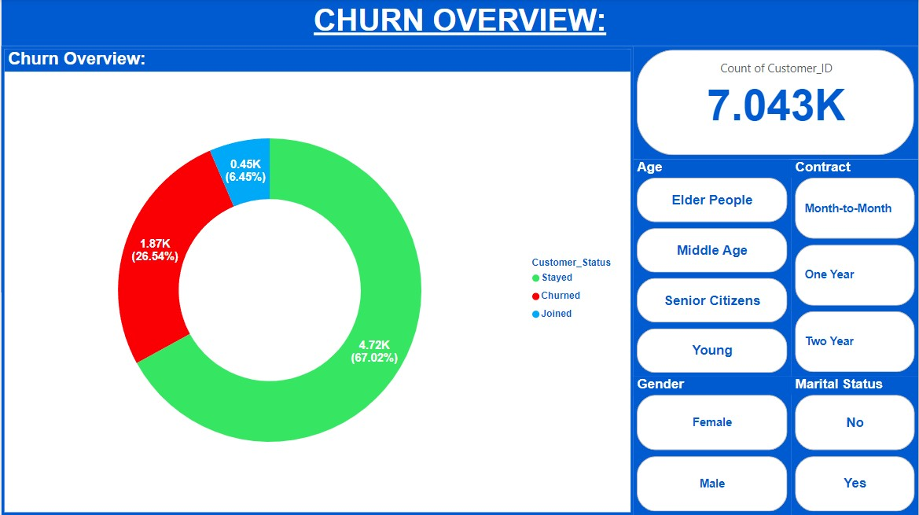
Churn Overview:
Objective:
To understand the proportion of churned vs. non-churned customers in the dataset.
Visualizations:
Type: Donut Chart, Fields – Legend: Customer_Status, Values: Customer_ID (Count)
Findings:
Churned customers make up 26.54% i.e 1869 customers of the customer base.
Whereas senior citizen (i.e: Customer age > 60) are of high 36.46% i.e 606 customers.
Whereas Male customers are of high 36.27% i.e 305 customers.
Whereas unmarried customers are of high 40.91% i.e 162 customers.
Whereas month on month customers are of high 67.69% i.e 155 customers.

Slide 10
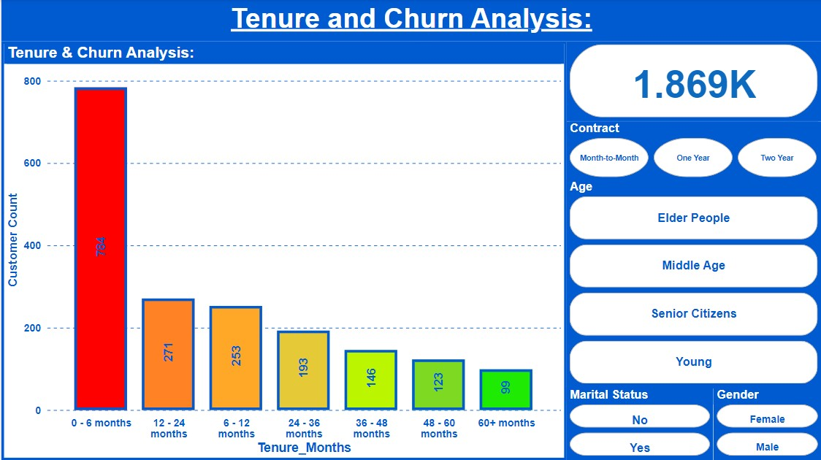
Tenure and Churn Analysis:
Objective: To analyze the relationship between Tenure and churn.
Visualization:
Type: Stacked Column Chart, Fields: X-Axis: Tenure Range (e.g., 0-6 months, 6-12 months, etc.), Y-Axis: Count of CustomerID, Legend: Tenure Range, Drill Drown: Customer status - churned.
Findings:
Churn rate is highest during the first 6 months count of customer is 784, from this the churned rate of customers based on contract type month on month is significantly high 780 count, from that senior citizen (age above 60) i.e. – 217 count and elder people (age between 45 to 60) i.e. – 200 count churned rates are significantly high, compare to male female in senior citizen are high in count i.e. – 118, and from that unmarried women are highly churned i.e. 93 count.
Customers with tenure over 60 + months show significantly lower churn rates count id 99.

Slide 11
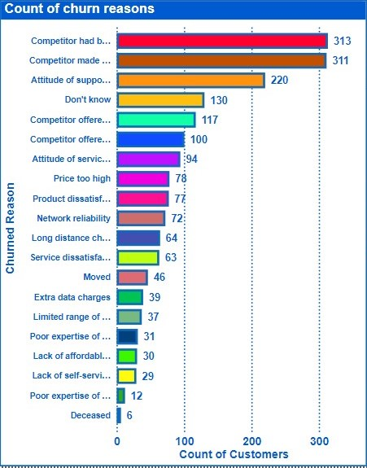
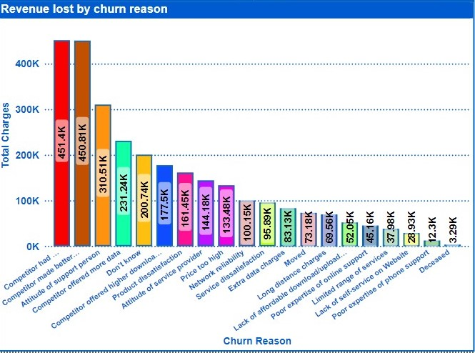
Churn Reasons and Financial Impact:
Objective: To understand reasons for churn and their financial impact.
Visualization:
Type: Horizontal Bar Chart, Fields- X-Axis: Count of CustomerID, Y-Axis: Churn Reason.
Type: Clustered Column Chart. Fields - X-Axis: Churn Reason, Y-Axis: Total Charges.
Findings:
Among the 20 reasons the top three major churn reasons are competitors provides better device are 313 counts, competitors provide better pricing are 311 counts and customer because of attitude of support person are 220 count a total count of 844 Customers i.e. 45.15% among the total 1869 churned customers. Among this whereas female customers counts are of 427 and male customer counts are of 417.
The highest revenue loss has also occurred due to the same 3 reasons only i.e. competitors provide better device ($451,400.30), competitors provide better pricing ($450,809.60) and attitude of support person ($310,508.35).

Slide 12
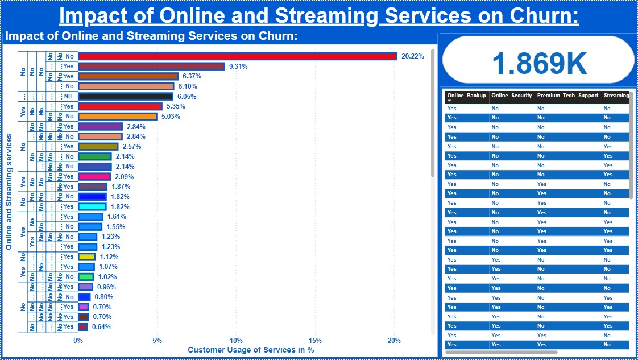
Impact of Online and Streaming Services on Churn:
Objective: To analyze the impact of services on churn.
Visualization:
Type: Cluster Bar Chart, Fields: Y-Axis: Services (e.g., Streaming TV, Streaming Movies, Streaming Music Online Backup, Online Security and Premium Tech Support), Y-Axis: Percentage of CustomerID.
Findings:
Among the Churned customers near to 20.22% of customers (i.e.378 customers) didn’t prefer any type of online service and streaming service. 9.31% customers (i.e. 174 customers) among the churned customers prefer only the streaming service.
Among all the churned customers only 1.61% of customers (i.e. 30 customers) prefer 2 service from online services and all 3 from streaming services.

Slide 13
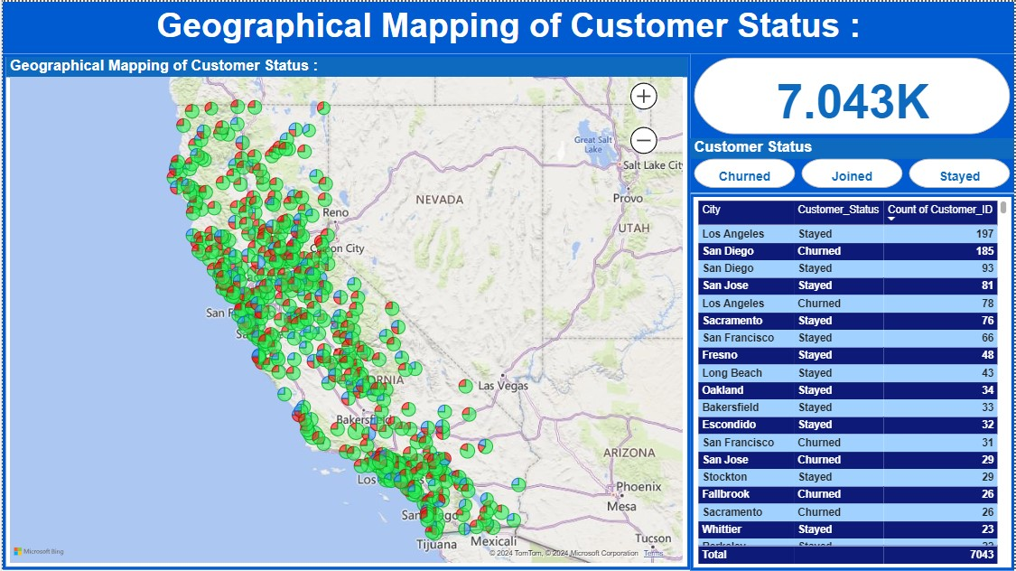
Geographical Mapping of Customer Status
Objective:
Visualize the distribution of customer status (e.g., Churned, Stayed, Joined) across different geographical locations.
Visualization:
Type: Map Chart, Fields: Location: City & Zip_Code for more granular data, Legend: Customer_Status, Size: Customer_ID (Count).
Type: Table, Fields: Columns – City, Customer status and Count of Customer.
Findings:
San Diego shows higher concentration of churned customers i.e. – 185 customers, indicating specific regional issues.
Los Angles shows higher rate of customers staying with the service i.e. – 197 customers.

Slide 14
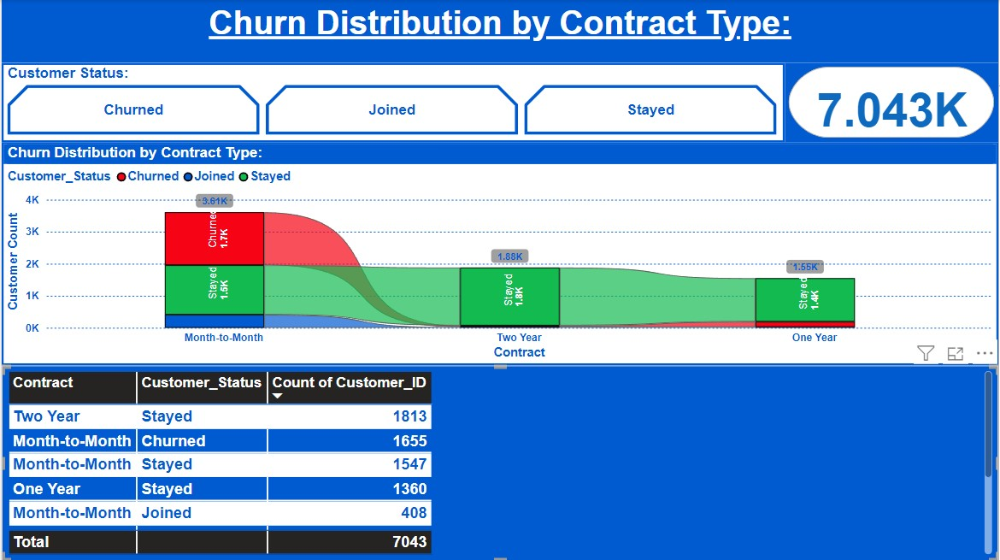
Churn Distribution by Contract Type:
Objective: To understand churn distribution across different contract types.
Visualization:
Type: Ribbon Chart, Fields Used: X-Axis: Contract_Type, Y-Axis: Count of Customer_ID, Legend: Customer_Status.
Type: Table – Contract, Customer status and Customer id_ count.
Findings:
Month-to-month contracts show significantly higher churn rates compared to yearly contracts.
Highest customers stay in 2 years contract type.

Slide 15
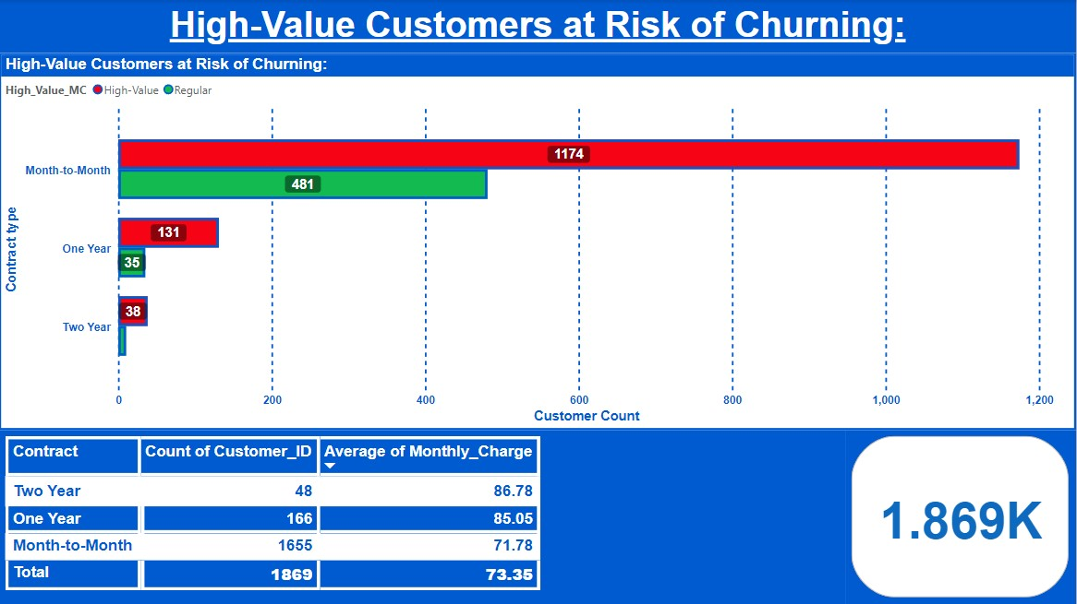
High-Value Customers at Risk of Churning:
Objective: To segment high-value customers who are at risk of churning based on thresholds.
Visualization:
Type: Matrix, Fields Used: Customer_ID, Monthly_Charges, Contract_Type, Customer_Status and High-Value.
Type: Cluster Bar Chart, Fields Used: Y-Axis – Contract, X-axis- Customer_ID in count, Legent – High_Value_MC, Filter – Customer_staus – Churned.
Findings:
Customers with month-to-month contracts and high monthly charges are at a greater risk of churning.
Since this is reference to the 1174 churned customers who are in month - to - month contract type customers with high value monthly charges (above the average of 63.60 which is the total average of monthly charges).

Slide 16
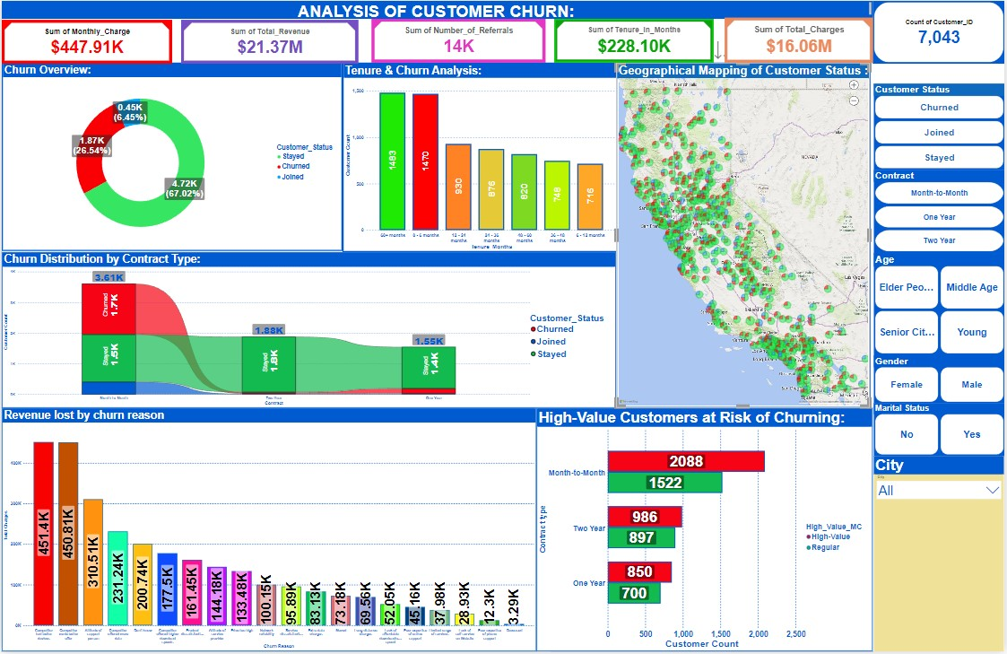

Slide 17
Recommendations to Reduce Churn :
Churn Rate by Category: 26.54% (1,869) churned, with high-risk groups: senior citizens (36.46%, 606), males (36.27%, 305), unmarried (40.91%, 162), and month-to-month users (67.69%, 155); offer targeted discounts and loyalty rewards.
Convert Month-to-Month Contracts:1,174 churned from month-to-month contracts; provide incentives to switch to long-term plans.
Improve Onboarding: 784 churned within the first 6 months; offer welcome deals and proactive support.
Address Churn Reasons: Competitor services ($451.40K), pricing ($450.81K), and support issues ($310.15K) caused revenue loss; implement price-matching and improve support.
Focus on High-Value Customers: 1,174 high-risk month-to-month customers churned; use personalized outreach and loyalty rewards to retain them.
Target High-Churn Regions: 185 churned in San Diego; offer regional promotions and improve local service.
Engage Key Tenure Segments: High churn between 6-12 months (253) and 12-24 months (271); focus retention on these segments.
Service Usage Analysis: 20.22% (378) churned without services, 9.31% (174) used only streaming; offer bundles and improve service quality.
Collect Feedback: Competitor issues caused a $1.2M loss; conduct post-churn surveys to gather insights and improve services.

Slide 18
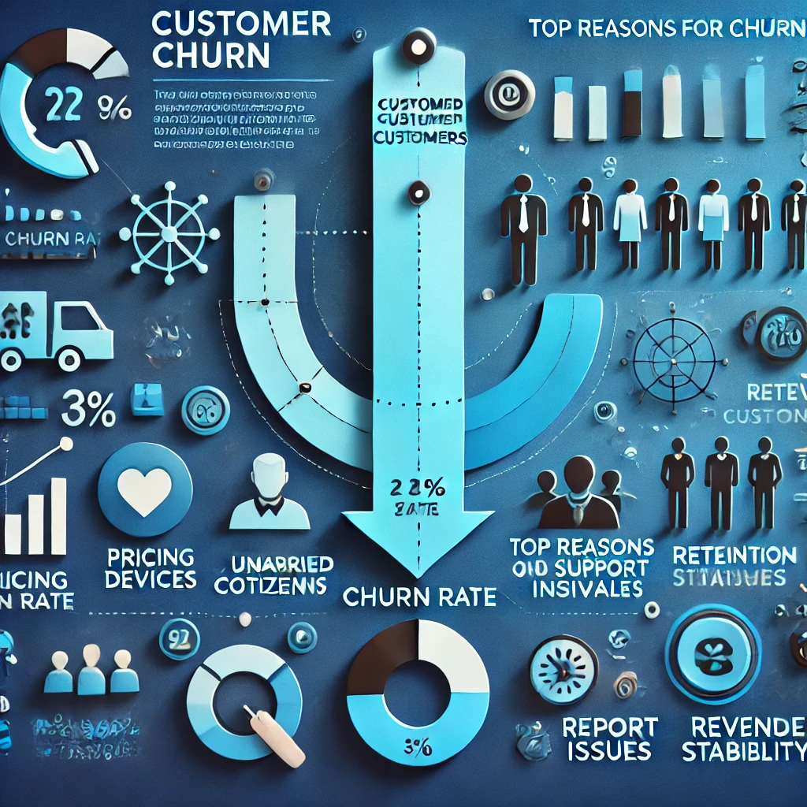
CONCLUSION:
Churn Insights: Churn rate is 26.54%, with early churn (within 6 months) and month-to-month contracts posing the highest risk.
Key Drivers: Competitor pricing, device offerings, and poor customer support are the main churn reasons.
Customer Patterns: Senior citizens, unmarried customers, and those with fewer services are more likely to churn. Two-year contracts and bundled services show better retention rates.
Recommendations: Focus on retaining high-risk groups with targeted offers, loyalty programs, and improved support. Promote long-term contracts and bundled services for higher customer loyalty.
Business Impact: Predictive analysis helps reduce churn, stabilize revenue, and enhance customer satisfaction.
With data-driven strategies, telecom companies can proactively address churn and drive long-term growth

Slide 19
THANK YOU

